Slide 1
Sensors

Slide 2
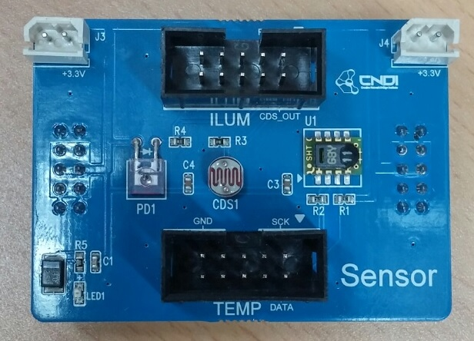
1. CDS Sensor

Slide 3
1. Connect CDS Sensor

Slide 4
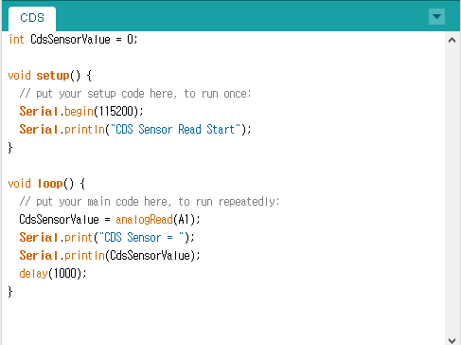
1. Example code of CDS Sensor

Slide 5
2. PD Sensor

Slide 6
2. Connect PD Sensor

Slide 7
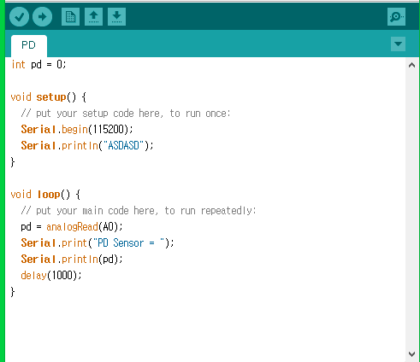
2. Example code of PD Sensor

